Slide 1
Die Cast Inspection
Using Artificial Intelligence – Form Recognizer to parse PDF forms

Slide 2
Use Case
Components or Parts made has to be sent to third party company to get that ceritified
Specification for the part or component made is also sent
The Third-party testing company can test the part or component made and then send back a PDF with specification and also the Pass or Fail result.
Component or parts passes then they are good for mass production
If component fails then analysis to what is wrong, find root cause analysis and then goes through fabrication process.

Slide 3
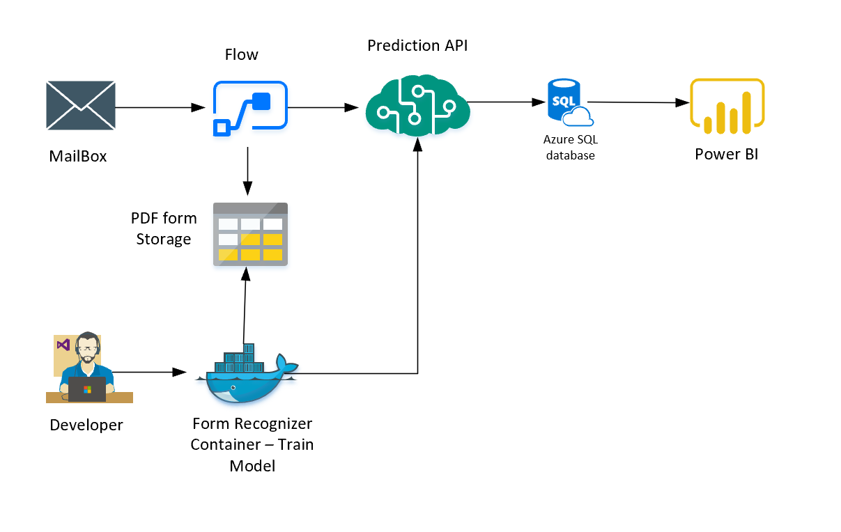
Architecture
Form Recognizer V2
New Web UI
Using Docker Containerized version
Reading it from Blob and Email
Model Build and Deploy
Use Power Automate to do RPA
Store pdf in blob for long term
Store Results in Azure SQL for reporting
Power BI and SharePoint for Reporting

Slide 4
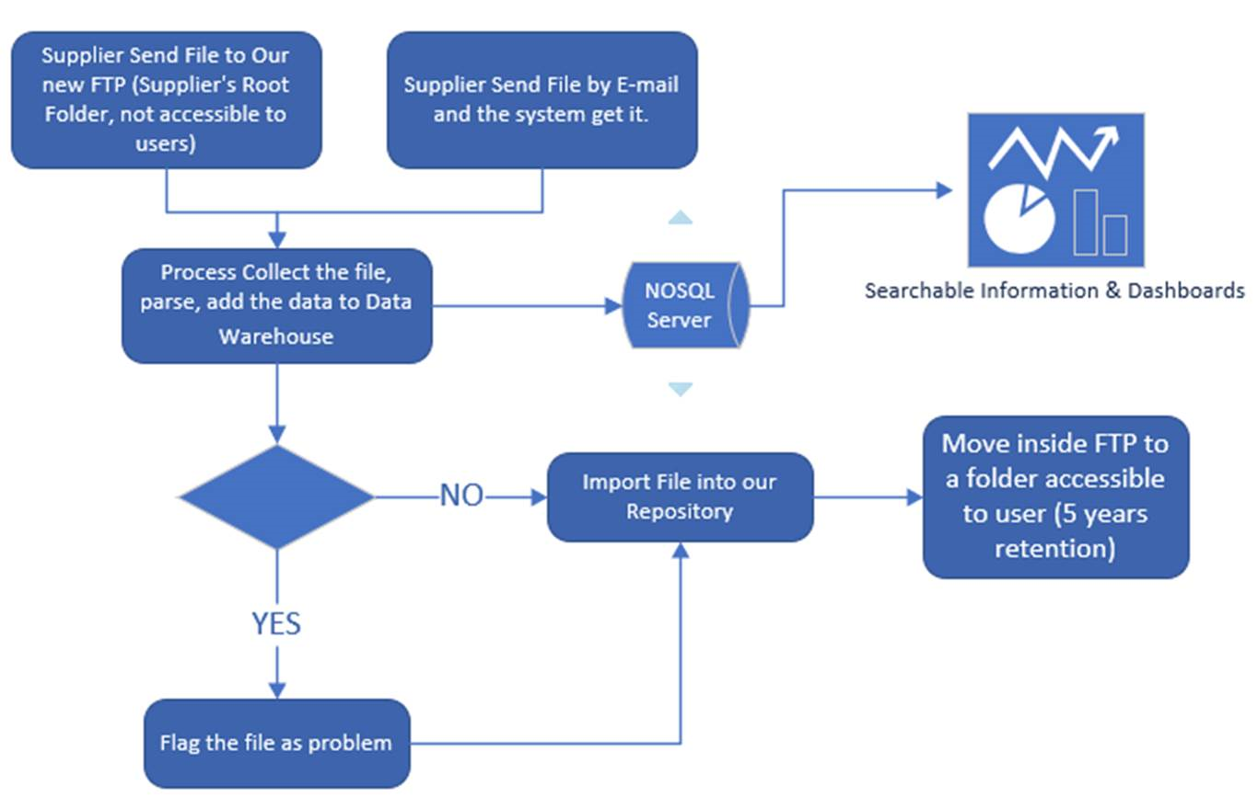

Slide 5
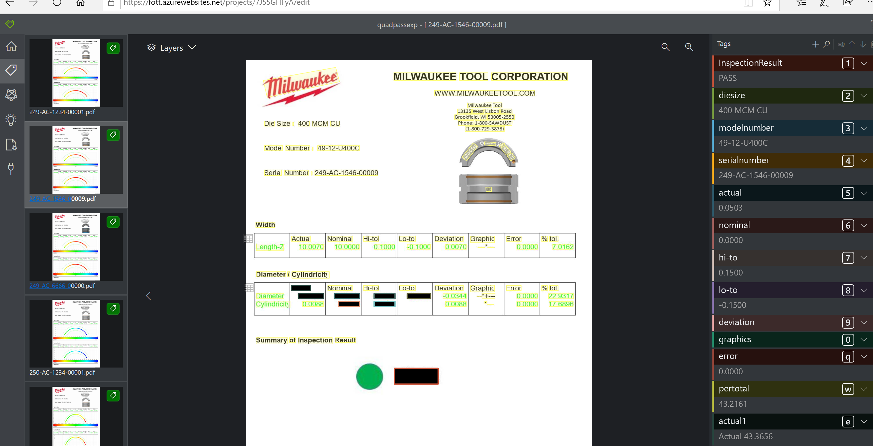

Slide 6
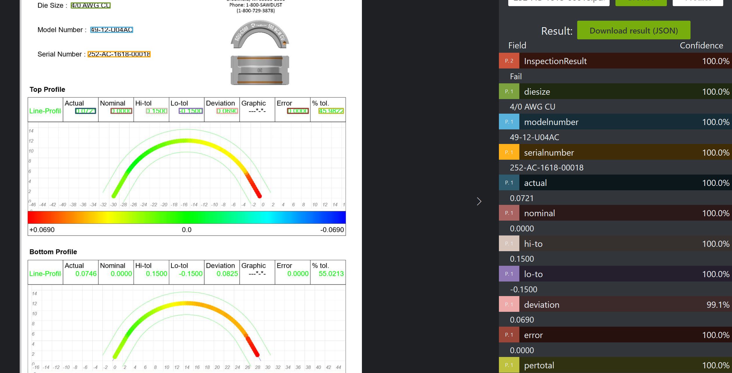

Slide 7
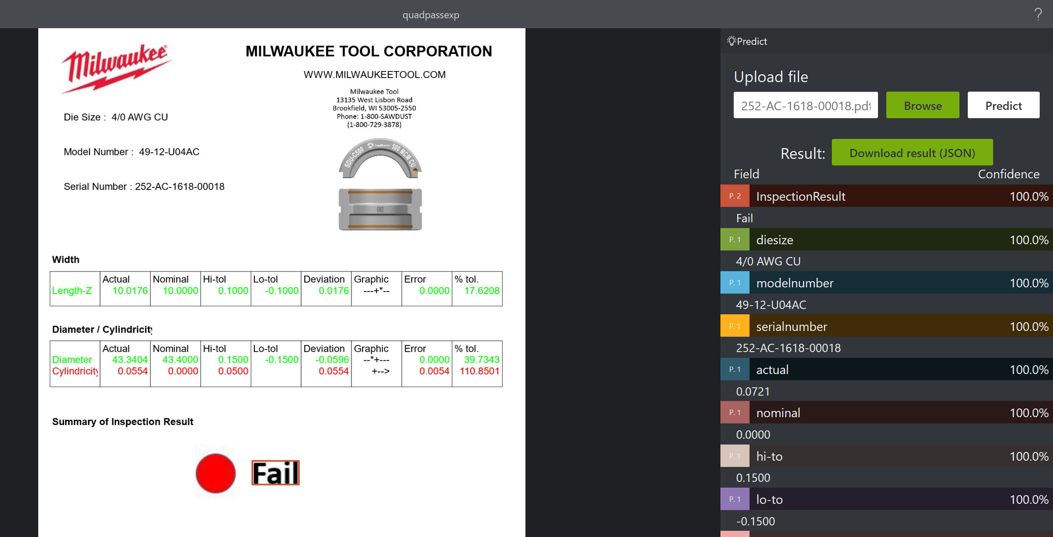

Slide 8
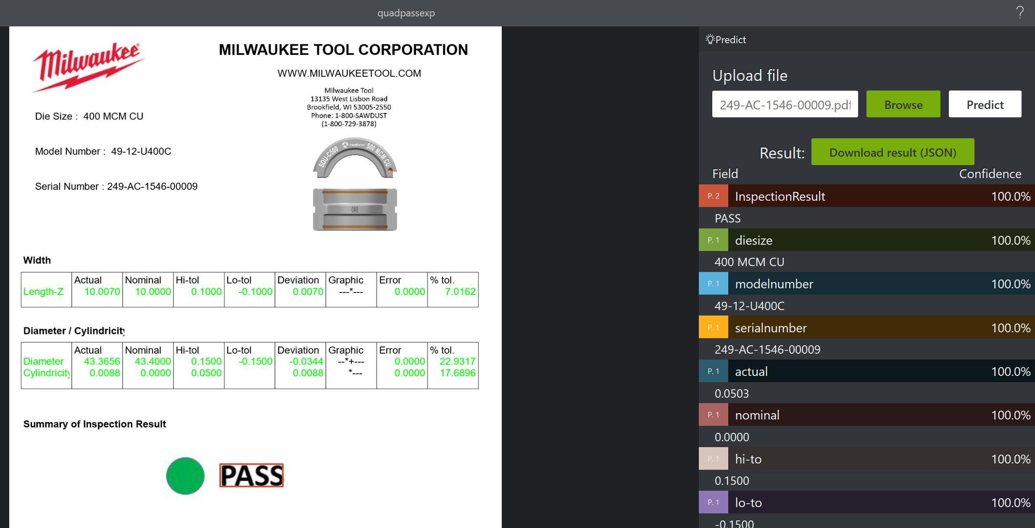

Slide 9
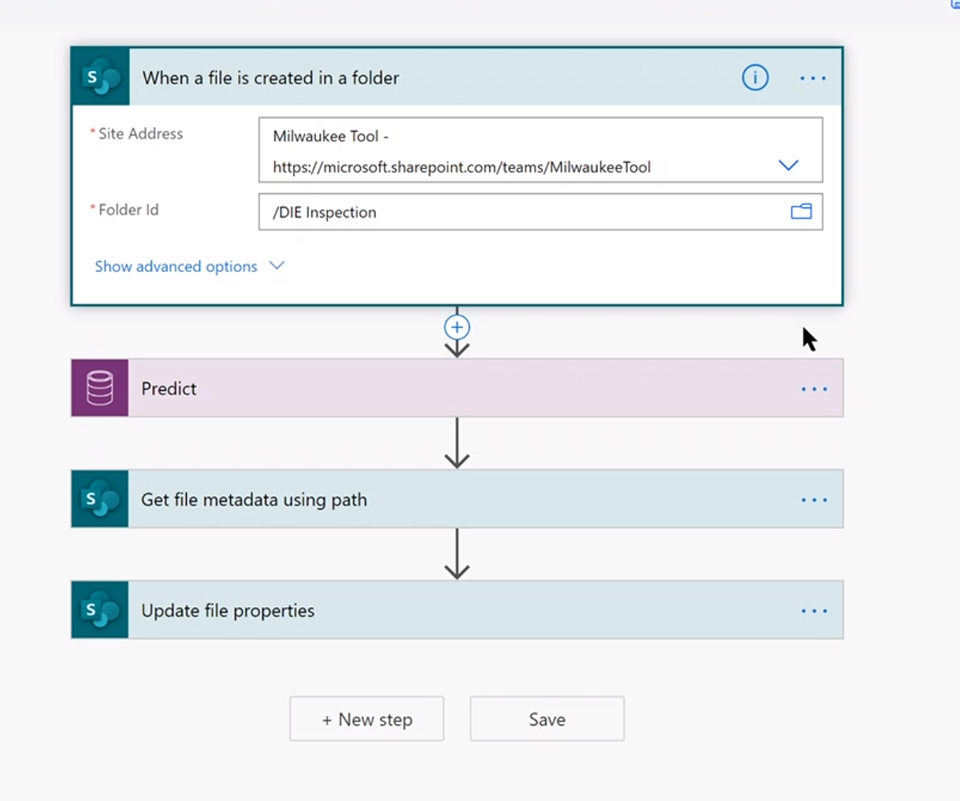

Slide 10
